Slide 1
Multivariate Time Series Forecasting with Transformers: Optimizing Prediction Performance
Zaitsev, A., Mahfoud, O.
University of Luxembourg

Slide 2
Outline
Project Overview
History of time series forecasting
Transformers & PatchTST
Data overview
Train / validation splits
Problem with multivariate TSTs
Results
Notes
Gained insight
Demo

Slide 3
Project Overview
Project Goal: Explore multivariate time-series forecasting using Transformer-based models to effectively capture spatial and temporal data dependencies.
Current Challenge: PatchTST, the state-of-the-art model, requires that the number of input features match the number of output features.
Proposed Solutions
  Solution 1: Introduce a Convolutional Autoencoder
  Solution 2: Enhance PatchTST with an encoder block
  Solution 3: Custom loss function
Validation Method: Propose a novel approach to split training and validation data by interspersing small validation batches throughout the timeline, aiming to boost model generalizability.

Slide 4
Time series forecasting: History
Statistical methods: AR (1920), ARIMA (1960), VAR (1980).
Machine learning methods: Linear Regression and SVMs (1990), Random Forest and Gradient Boosting (2000).
Deep learning methods: RNNs (2010s), LSTMs (2010s), GRUs (2010s)
Transformers: “Attention is all you need” (2017) => Transformers for time series forecasting (since 2018).
Notice the trend: at first trying to handle temporal dependencies, then temporal + spatial dependencies.

Slide 5
Transformers: History
Transformer model introduced by Vaswani et al. (2017) for natural language processing tasks in “Attention is all you need” paper.
Researchers adapt the idea for computer vision (Khan et al., 2021), Speech (Karita et al., 2019) tasks.
Works well with sequence data!
Finally: Transformers in Time Series: A Survey (Wen et al., 2022) – general overview of current use of Transformers for time series data.

Slide 6

Transformers: Overview
Transformers: neural network architecture
Processes sequential data.
Uses self-attention mechanism to weigh the influence of different parts of the input sequence.
Captures long-range dependencies.
Efficient for parallel processing.
Figure 1. Transformer architecture.
Vaswani et al. “Attention is all you need”. 2017

Slide 7
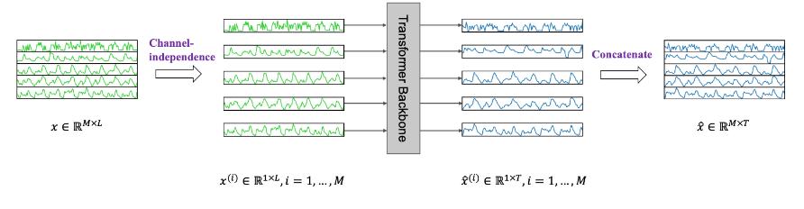
Transformers: PatchTST
Segmentation of time series into subseries-level patches which serve as input tokens to the Transformer.
Channel-independence where each channel contains a single univariate time series that shares the same embedding and Transformer weights across all the series, i.e. a global univariate model.
Figure 2. PatchTST general idea. Nie et al. “A Time Series is Worth 64 Words: …”. 2022

Slide 8
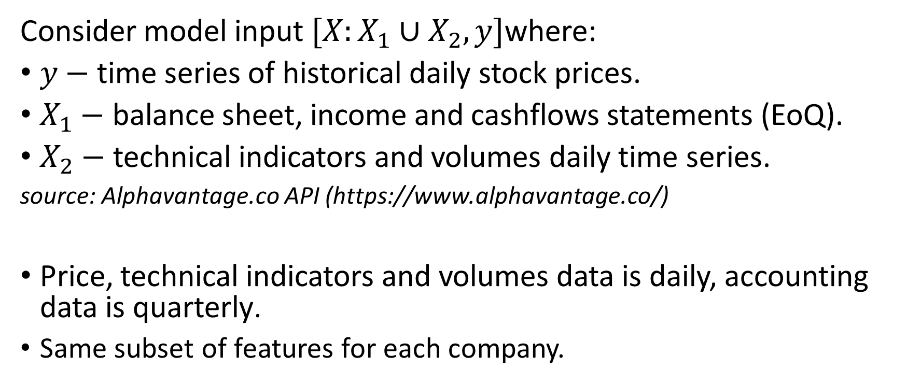
Data: quick overview | Definition
Consider model input $[X:X_{1}∪X_{2}, y]$where:
$y−$time series of historical daily stock prices.
$X_{1}−$ balance sheet, income and cashflows statements (EoQ).
$X_{2}−$ technical indicators and volumes daily time series.
source: Alphavantage.co API (https://www.alphavantage.co/)
Price, technical indicators and volumes data is daily, accounting data is quarterly.
Same subset of features for each company.

Slide 9
Data: quick overview | Feature Selection, Splitting & Scaling
We perform feature selection with the help of Random Forest and XGBoost algorithms. We rank the features based on their importance scores towards the price feature (use feature if importance >4%).
We find importance scores for each feature for each company => sum them up and divide by the number of companies we have.
Train / validation sets splitting (see “Train / validation splits”).
Scaling: standardization (mean 0, std 1).

Slide 10
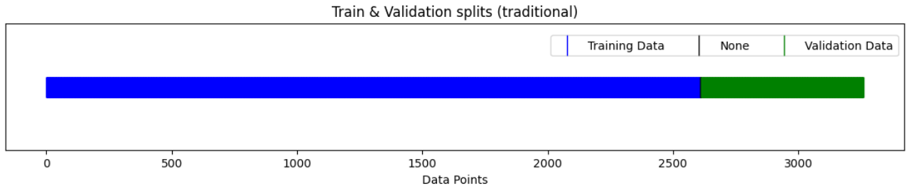
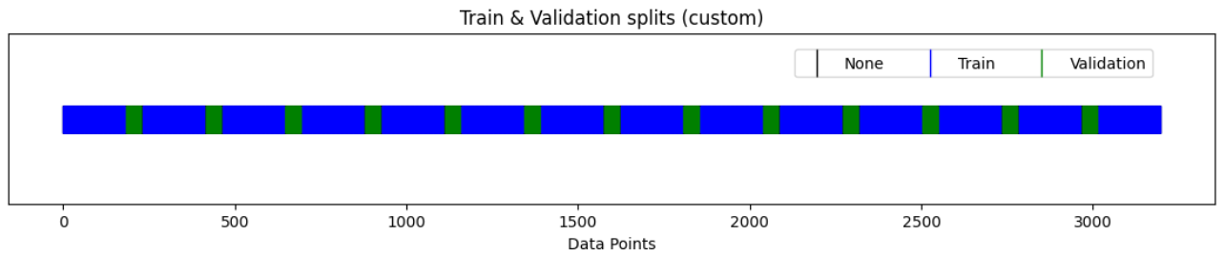
Train / validation splits: traditional & our approaches
Figure 3. Traditional and our train / validation split methods

Slide 11
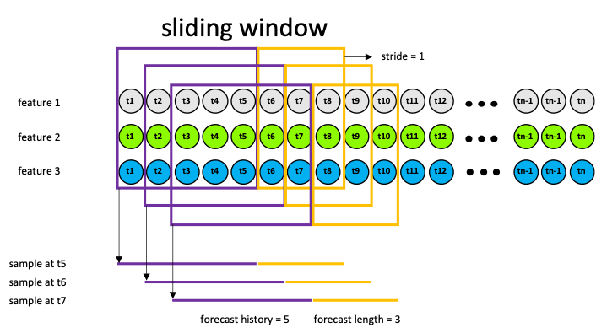
Preprocessing for Transformers: lookback & prediction windows
60
5
Figure 4. Sliding window data preprocessing approach for PatchTST network

Slide 12
Problem with multivariate TSTs: same input & output feature sets
Transformers require same input & output feature sets, limiting flexibility in predicting fixed features while incorporating broader input, restricting ability to leverage richer input for improved accuracy.
RSI, Assets, Inventory, Volume, Goodwill, Real Upper Band, Estimated EPS, Total Revenue, …
PRICE

Slide 13
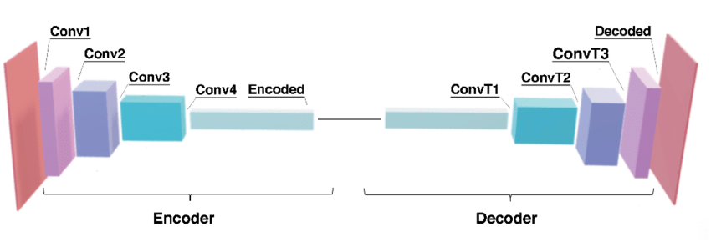
Problem with multivariate TSTs : solution idea 1: Convolutional Autoencoder
Train separate Convolutional Autoencoder model and use the encoder portion to extract a latent representation of the input data with a lower dimensionality compatible with the output dimensionality.
Figure 5. Convolutional autoencoder architecture

Slide 14
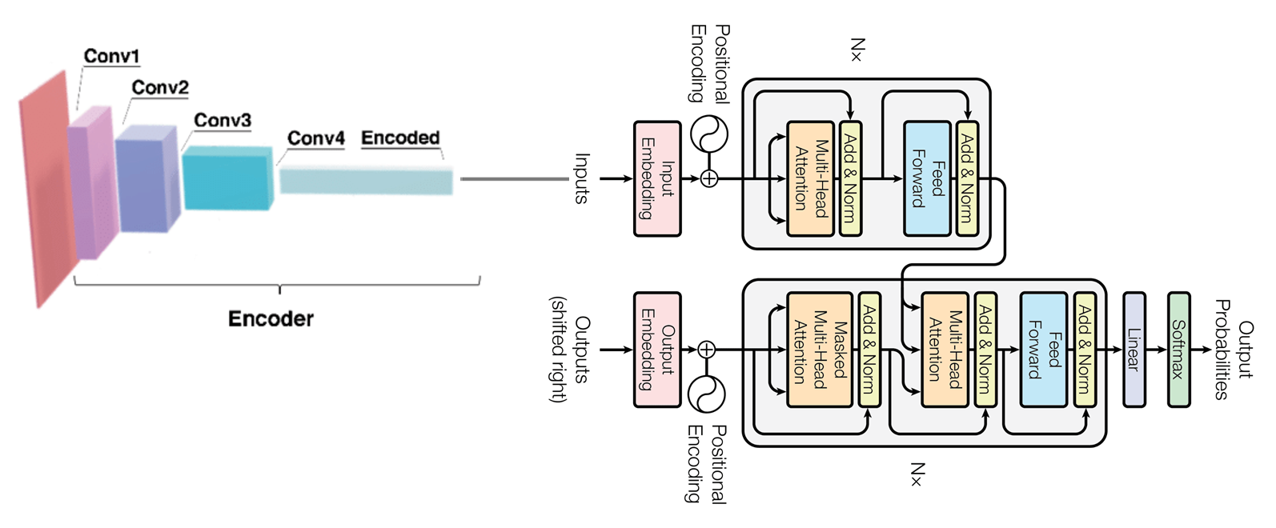
Problem with multivariate TSTs: solution idea 2: Encoder + TST
Integrate an encoder block directly into the Transformer architecture as the initial layers, so that the model can learn itself how to transform given data into a lower dimensional representation.
Figure 6. Encoder + TST architecture

Slide 15
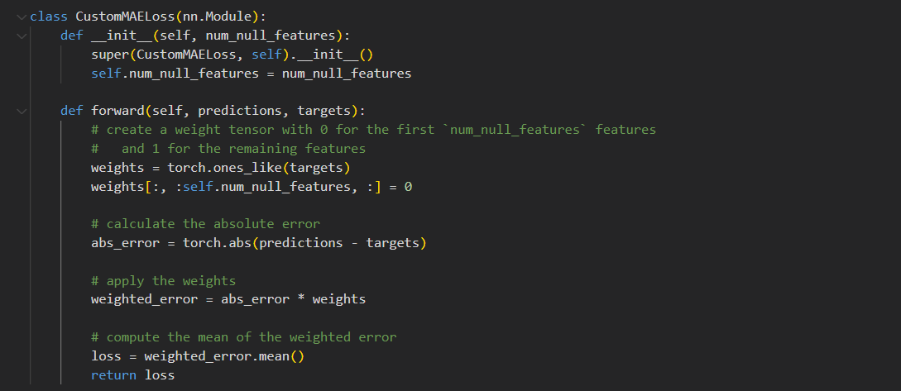
Problem with multivariate TSTs: solution idea 3: custom loss function
Use all data during training, but nullify all features except “price” features in the loss function by setting their weights to zero, ensuring they do not contribute to the loss calculation.
Figure 7. Custom loss function

Slide 16
Results

Slide 17
Results: default / custom splits
Results are best on the test set that the model has never seen before. We used the same model architecture for all results. Best model architecture was found for default split using Optuna
Default split: 0.5162 (MAE)
Custom split: 0.2078 (MAE)

Slide 18
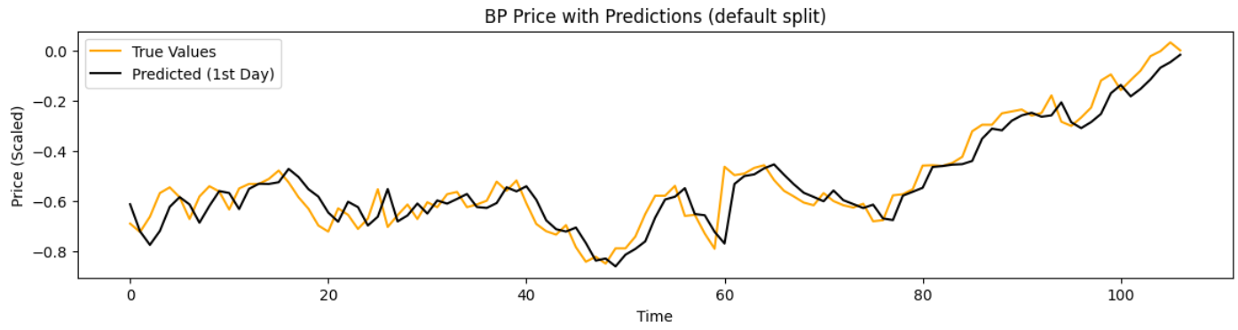
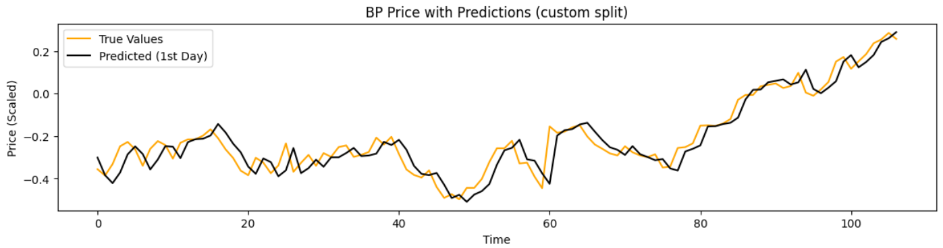
Results: default vs custom split (1 day)
Figure 8. Model performance trained on the default and custom splits results on the test set (1 day prediction)

Slide 19
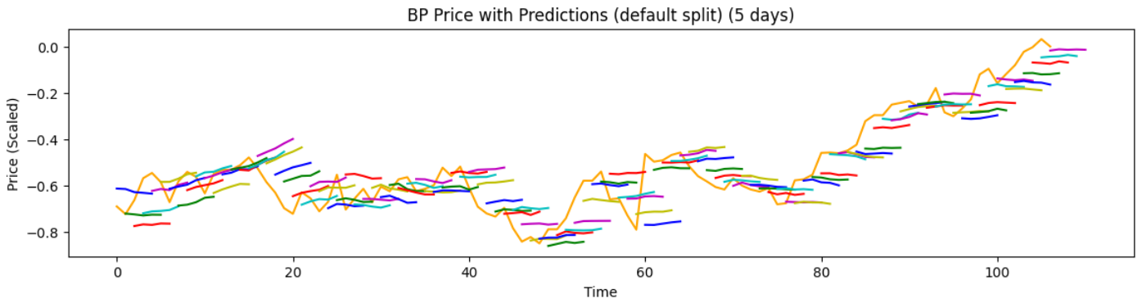
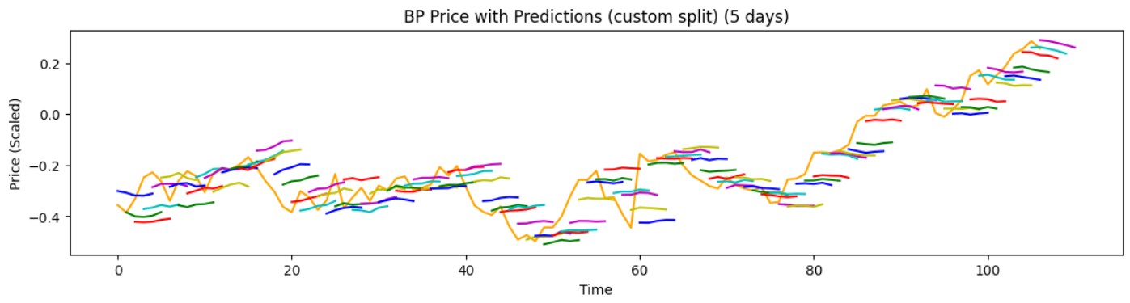
Results: default vs custom split (5 days)
Figure 9. Model performance trained on the default and custom splits results on the test set (5 day prediction)

Slide 20
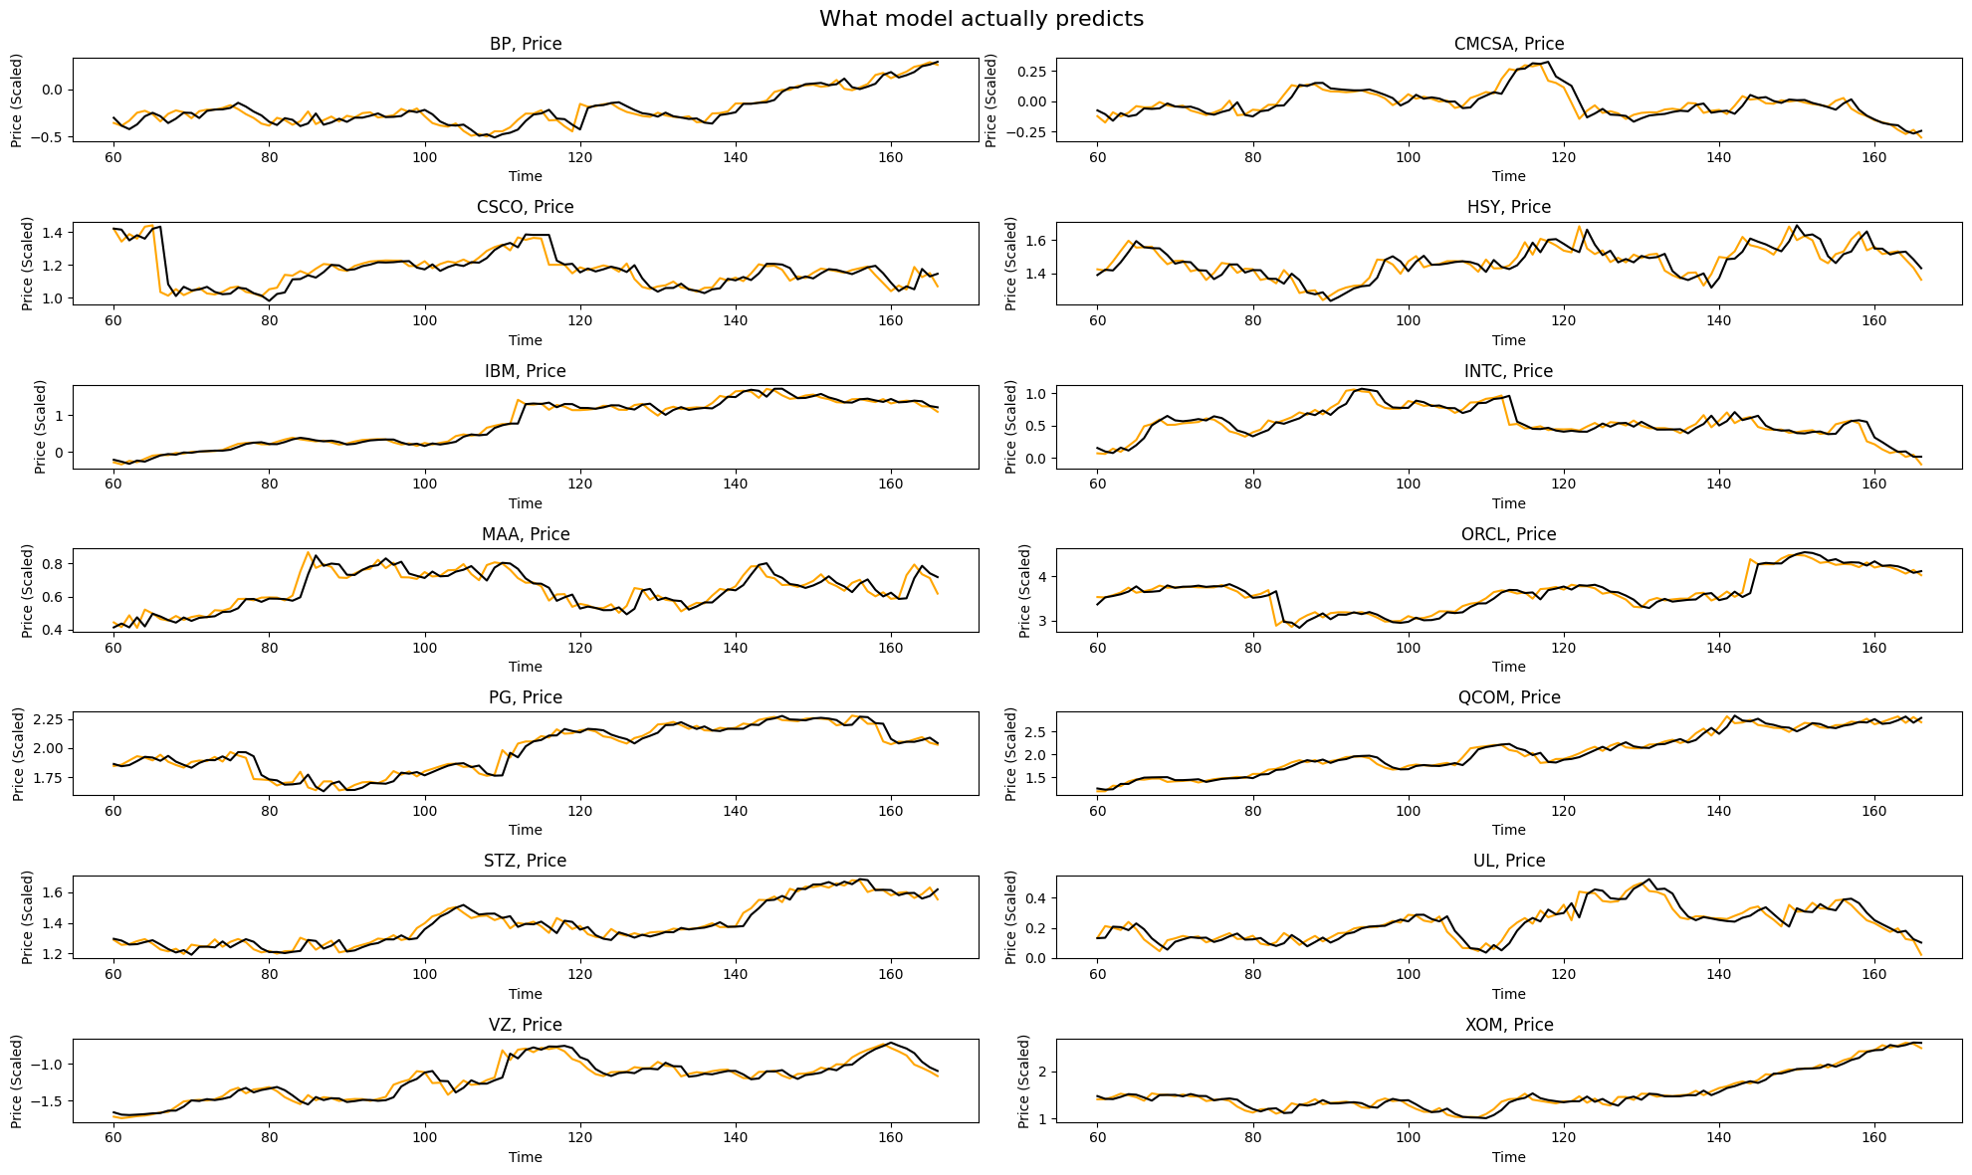
Figure 10. Actual output of the model

Slide 21
Results: weighted loss
Issue: bad forecasting for later days (which makes sense, since data becomes more and more random).
Possible solution: add weights in loss function.
Weights: [0.5, 1, 1.5, 2, 2.5].
Results:
  Custom split, no weights: 0.2078
  Custom split, weighted: 0.2113

Slide 22
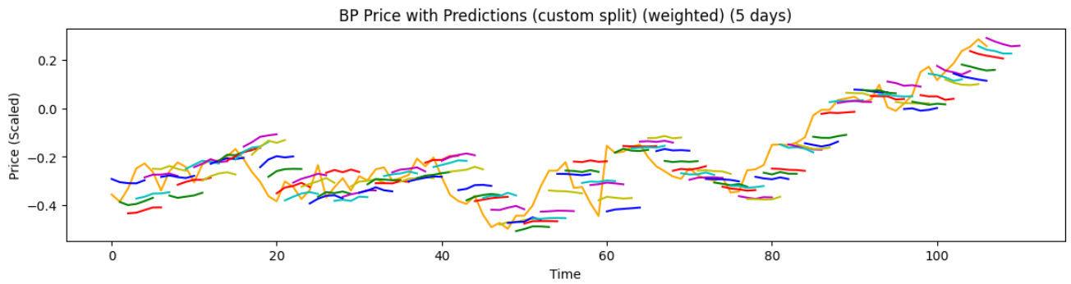
Results: weighted loss
Figure 11. Comparison in model performance without weighted loss vs with weighted loss (5 day prediction)

Slide 23
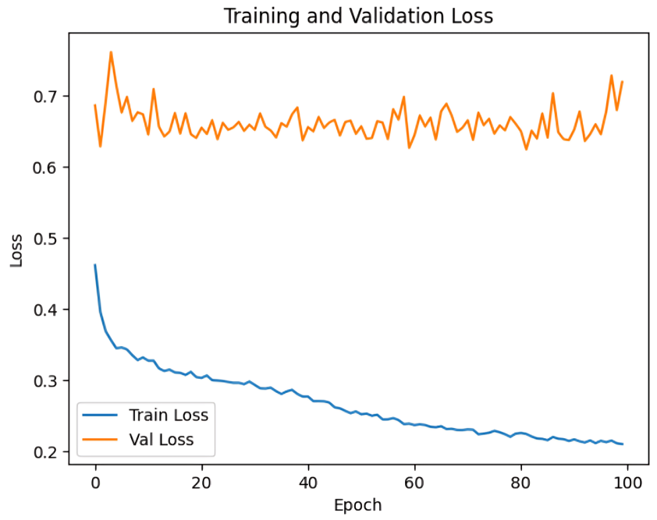
Results: additional features
separate Autoencoder
Result: no convergence, the model is not able to learn how to properly represent data in the lower dimensional space.
We tried adding skip connections, more encoding/decoding layers, FC layers.
Figure 12. Autoencoder training results

Slide 24
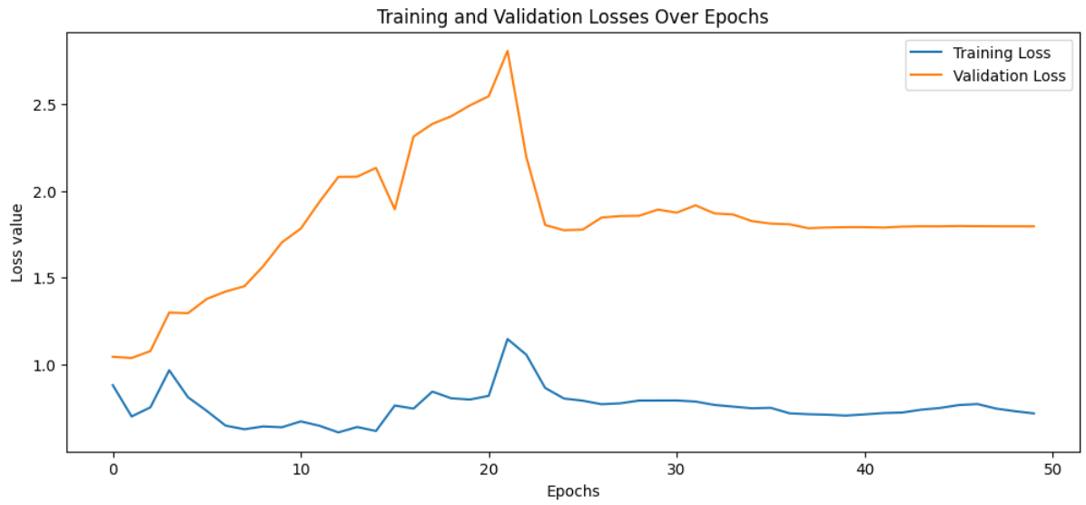
Results: additional features
Encoder + TST
No convergence. It is hard for the model to make predictions based on the encoded data.
Figure 13. Encoder + PatchTST training results

Slide 25
Results: additional features
nullifying not “price” features
Prioritizing the accuracy for the features specified for optimization (prices only) while encouraging the model to capture relationships between all the features in the data.
Custom split, only price features: 0.2078
Custom split, use all features: 0.2033

Slide 26
Notes | Cyclical learning rates
During training we used 1cycle policy (cyclical learning rates) introduced by Smith in 2015 to find the optimal learning rate(s).
1cycle policy “practically eliminates the need to experimentally find the best values and schedule for the global learning rates”.
“Instead of monotonically decreasing the learning rate, this method lets the learning rate cyclically vary between reasonable boundary values” => “higher learning rates help in coming out of saddle points and the lower learning rates prevents the training from diverging”

Slide 27
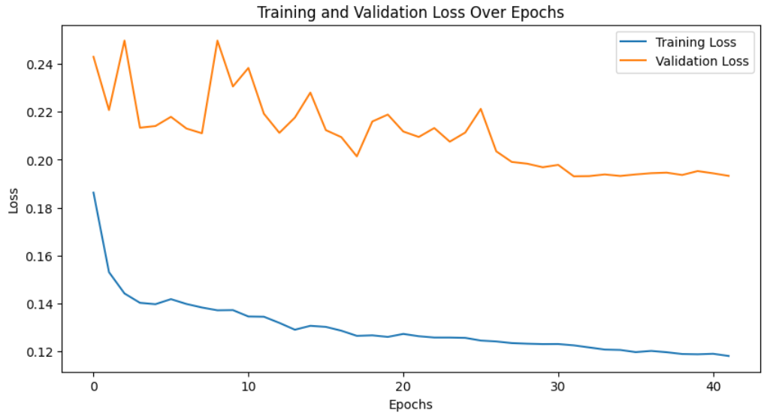
Notes | Cyclical learning rates
Figure 14. Cyclical learning rates example

Slide 28

Notes |Optuna
During training we used Optuna library.
It is used for hyperparameter optimization, specifically for automating the search process to find the optimal set of hyperparameters for machine learning models.
Trial 0 finished with value: 3.070014476776123 and parameters:
{'n_layers': 4, 'n_heads': 4, 'd_model': 12, 'd_ff': 128, 'attn_dropout': 0.5, 'dropout': 0.0, 'patch_len': 30, 'learning_rate': 0.0008668672002100416}.
Best is trial 0 with value: 3.070014476776123.
Figure 15. Optuna

Slide 29
Recap
We discussed the history of time-series forecasting and current state-of-the-art methods.
We talked about which data we used and what data preprocessing techniques we applied to the data.
We proposed a train / validation splitting technique for time series data, which turned out to be better than the default one.
We proposed 3 methods to address the limitations of the existing multivariate time series forecasting Transformer-based models and enhance their performance. Only 1 of the methods worked, however.

Slide 30
Gained insight
Using default time-series split technique leads to bad performance.
Trying to encode high dimensional time-series data into a low dimensional data is not worth it.
Just predicting the next values proved to be not possible. Focus on predicting the probability whether the price will go up or down.
Since using all the features led to better results, that might be a good idea to include more technical indicators.
Try more complex architectures for higher dimensional data and model ensembles.

Slide 31
Demo

Slide 32
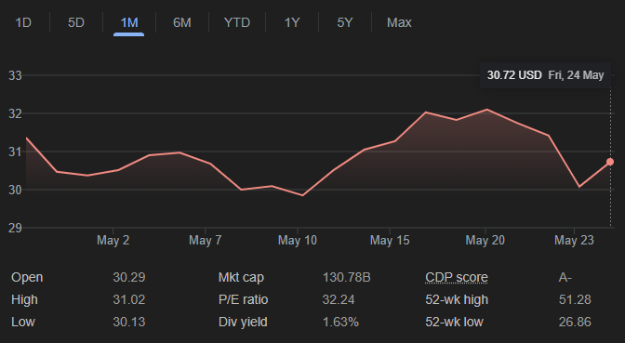
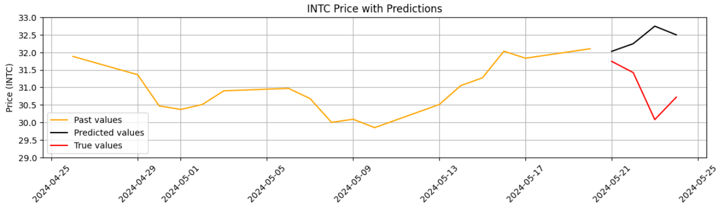

Slide 33
Thank you for your attention

Slide 34
References
Ashish Vaswani, Noam Shazeer, Niki Parmar, Jakob Uszkoreit, Llion Jones, Aidan N. Gomez, Lukasz Kaiser, and Illia Polosukhin. Attention is all you need, 2023.
Salman Khan, Muzammal Naseer, Munawar Hayat, Syed Waqas Zamir, Fahad Shahbaz Khan, and Mubarak Shah. Transformers in vision: A survey. ACM Computing Surveys, 54(10s):1–41, January 2022.
Shigeki Karita, Nanxin Chen, Tomoki Hayashi, Takaaki Hori, Hirofumi Inaguma, Ziyan Jiang, Masao Someki, Nelson Enrique Yalta Soplin, Ryuichi Yamamoto, Xiaofei Wang, Shinji Watanabe, Takenori Yoshimura, and Wangyou Zhang. A comparative study on transformer vs rnn in speech applications. In 2019 IEEE Automatic Speech Recognition and Understanding Workshop (ASRU). IEEE, December 2019.
Qingsong Wen, Tian Zhou, Chaoli Zhang, Weiqi Chen, Ziqing Ma, Junchi Yan, and Liang Sun. Transformers in time series: A survey. arXiv preprint arXiv:2202.07125, 2023.
Yuqi Nie, Nam H. Nguyen, Phanwadee Sinthong, and Jayant Kalagnanam. A time series is worth 64 words: Long-term forecasting with transformers, 2023.
Leslie N. Smith. Cyclical learning rates for training neural networks, 2017.

